Slide 1


Azure Kubernetes Service
Accelerate Growth on Cloud

Slide 2
Agenda
What is Containerization
Kubernetes Components
What is Orchestration
Kubernetes Architecture
Architecture of Containerization
Introduction to Kubernetes

Slide 3
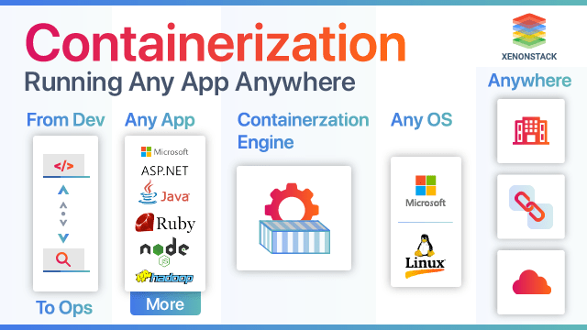
What is Containerization?
Containerization is the packaging together of software code with all its necessary components like libraries, frameworks, and other dependencies so that they are isolated in their own "container.“
Containerized applications can be run on various types of infrastructure—on bare metal, within VMs, and in the cloud—without needing to refactor it for each environment.
With containerization technology, there’s less overhead during startup and no need to set up a separate guest OS for each application since they all share the same OS kernel. Because of this high efficiency, containerization is commonly used for packaging up the many individual microservices that make up modern apps.
Copyright (c) 2019. Blazeclan Technologies Pvt. Ltd.

Slide 4
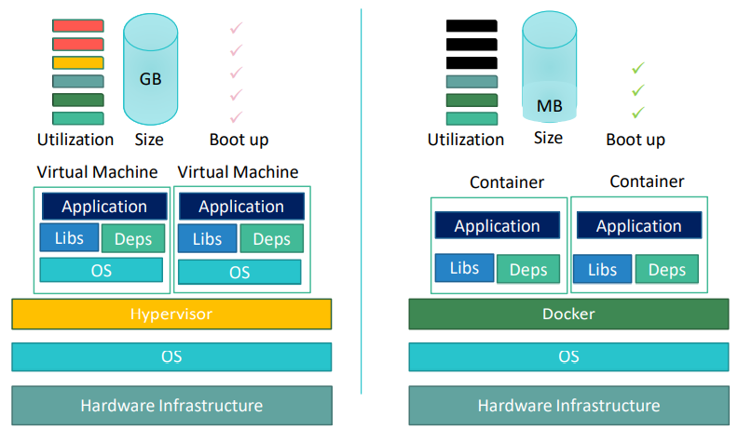
Architecture
Each container is an executable package of software, running on top of a host OS. A host may support many containers (tens, hundreds, or even thousands) concurrently, such as in the case of a complex microservices architecture that uses numerous containerized application delivery controllers (ADCs). This setup works because all containers run minimal, resource-isolated processes that others cannot access.
Think of a containerized application as the top layer of a multi-tier cake:
Copyright (c) 2019. Blazeclan Technologies Pvt. Ltd.

Slide 5
Containerization Architecture
At the bottom, there’s the hardware of the infrastructure in question, including its CPU(s), disk storage, and network interfaces.
Above that is the host OS and its kernel—the latter serves as a bridge between the software of the OS and the hardware of the underlying system.
The container engine and its minimal guest OS, which are particular to the containerization technology being used, sit atop the host OS.
At the very top are the binaries and libraries (bins/libs) for each application and the apps themselves, running in their isolated user spaces (containers).
Copyright (c) 2019. Blazeclan Technologies Pvt. Ltd.

Slide 6
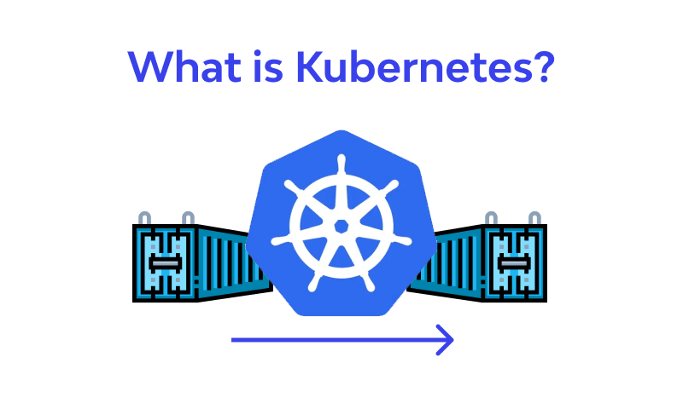
Introduction to Kubernetes
Kubernetes is a popular open source platform for container orchestration. It enables developers to easily build containerized applications and services, as well as scale, schedule, and monitor those containers.
It orchestrates the deployments and management of 100s and 1000s of containers in a clustered environment.
Containerization has bought a lot of flexibility for developers in terms of managing the deployment of the Applications. However, the more granular the application is the more components it consists of and hence requires some sort of management for those
One Still needs to take care of scheduling the deployment of a certain number of containers to a specific node, managing networking between the containers, following the resource allocation moving them around as they grow, and much more

Slide 7
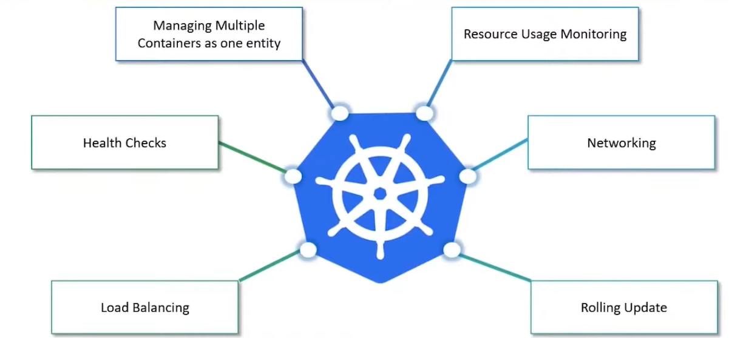
Kubernetes Features

Slide 8
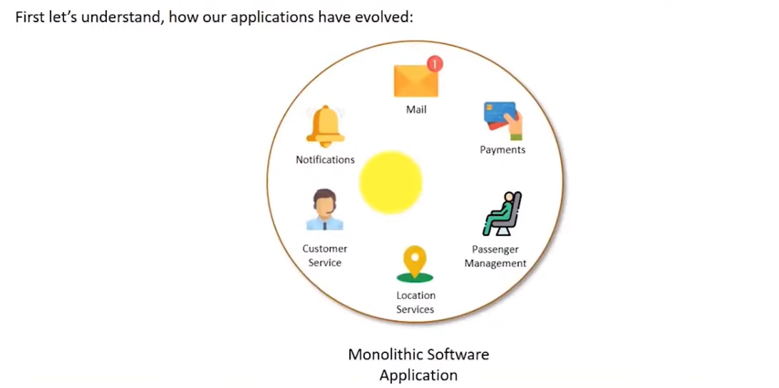
Why Kubernetes

Slide 9
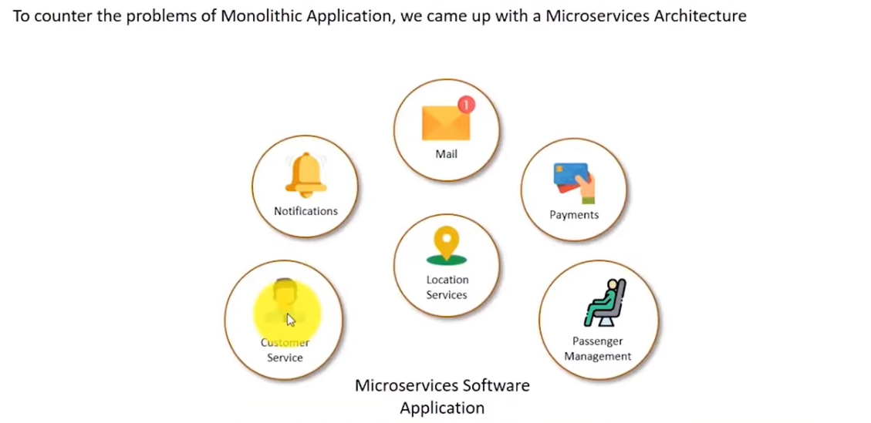
Why Kubernetes

Slide 10
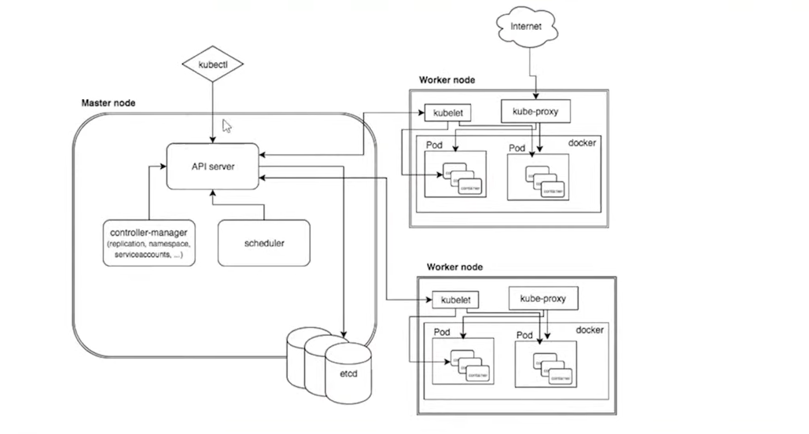
Kubernetes Architecture
Components of Master
etcd - distributed reliable key-value store used by Kubernetes to store all data used to manage the cluster
API SERVER
Kubernetes is an API server that provides all the operations on clusters using the API. API server implements an interface, which means different tools and libraries can readily communicate with it.
kubeconfig is a package Along with the server-side tools that can be used for Communication. It exposes Kubernetes API
Kube-apiserver is designed to scale horizontally-that is, it scales by deploying more instances. You can run several instances of kube-apiserver and balance traffic between those instances
Copyright (c) 2019. Blazeclan Technologies Pvt. Ltd.

Slide 11
Kubernetes –Components of Master
Kube-Controller-Manager
The brain behind orchestration. They are responsible for noticing and responding when nodes, containers, or endpoints go down, The controllers make decisions to bring up new containers. There are various components of the Controller
Node Controller: Responsible for noticing and responding when nodes go down
Replication Controller: Responsible for maintaining the correct number of pods for every replication controller object in the system
Endpoint Controller: Populates the Endpoints object (i.e.. joins services& Pods)
Service Account & Token Controllers: Create default accounts and API access tokens for new namespaces.
Copyright (c) 2019. Blazeclan Technologies Pvt. Ltd.

Slide 12
Kubernetes –Components of Master
Scheduler - responsible for distributing work or containers across multiple nodes. This is the mechanism responsible for allocating pods to available nodes. The scheduler is responsible for workload utilization and allocating pod to the new node.
Cloud-controller-manager
Cloud-controller-manager runs controllers that interact with the underlying cloud providers. cloud-controller-manager allows the cloud vendor's code and the Kubernetes code to evolve independently from each other.
The following controllers have cloud provider dependencies:
Node Controller: For checking the cloud provider to determine if the node has been deleted in the cloud after it stops responding
Route Controller: For setting up routes in the underlying cloud infrastructure
Copyright (c) 2019. Blazeclan Technologies Pvt. Ltd.

Slide 13
Kubernetes Architecture
Components of Master
Service Controller: For creating, updating, and deleting cloud provider load balancers
Volume Controller: For creating, attaching, and mounting volumes and interacting with the cloud provider to orchestrate volumes
What is Node?
Node- A node is a machine(physical or virtual) on which Kubernetes is installed. A node is a worker machine and this is where containers will be launched by Kubernetes.
Components of Node :
Container Runtime: It’s software that is responsible for running containers. Kubernetes supports several container runtimes. Docker,Containerd,cri-o,rktlet, and any implementation of the Kubernetes CRI (Container Runtime Interface)
Copyright (c) 2019. Blazeclan Technologies Pvt. Ltd.

Slide 14
Kubernetes – Node Components
Components of Node :
Kubelet Service: This is a small service in each node responsible for relaying information to and from control plane services. It interacts with etcd store to read configuration details and right values
Kubelet service communicates with the master component to receive commands and work. The kubelet process then takes responsibility for maintaining the state of work and the node server. It manages network rules, port forwarding, etc.
Kube-Proxy-service: This Service runs on each node and helps in making services available to the external host. It helps in forwarding the request to correct containers and is capable of performing primitive load balancing making sure that the networking environment is predictable and accessible and at the same time, it is isolated. It manages pods on nodes, volumes, secrets, creating new containers health checkups, etc.
Copyright (c) 2019. Blazeclan Technologies Pvt. Ltd.

Slide 15

thank you
Notes:
Do Not edit this Slide, This is Thank you in motion

